Slide 1
How Bad Has COVID-19 Been for the Stock Market?
By: Jacob Avchen, Jacob Hollander, and Salvatore Russo

Slide 2
Question 1:
Which Markets Have Been Most Negatively Impacted by the Spread of COVID-19?
We examine a sampling of companies from different industries to determine which ones are being hit the hardest.
We broke our sample of 35 companies into 7 categories with 5 companies in each category to compare to each other. We also took data from 5 ETFs to get rough approximations of entire industries, and the DOW Jones Industrial Average and S&P 500 Indexes.
The following slides will show the hardest hit or most interesting industries to look at.

Slide 3
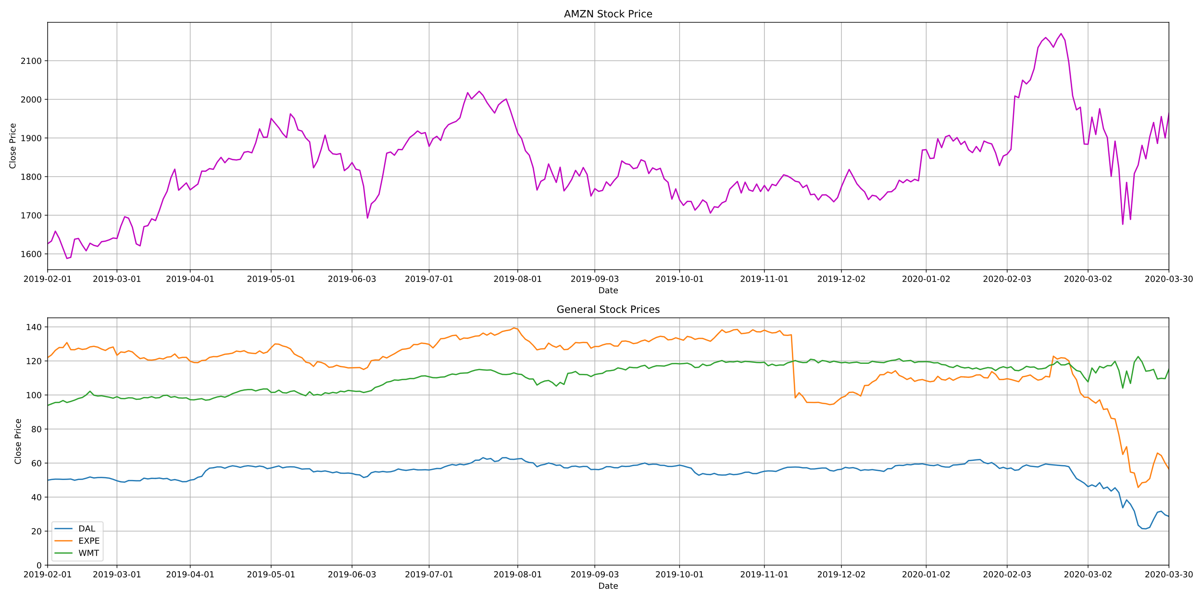
General Stocks

Slide 4
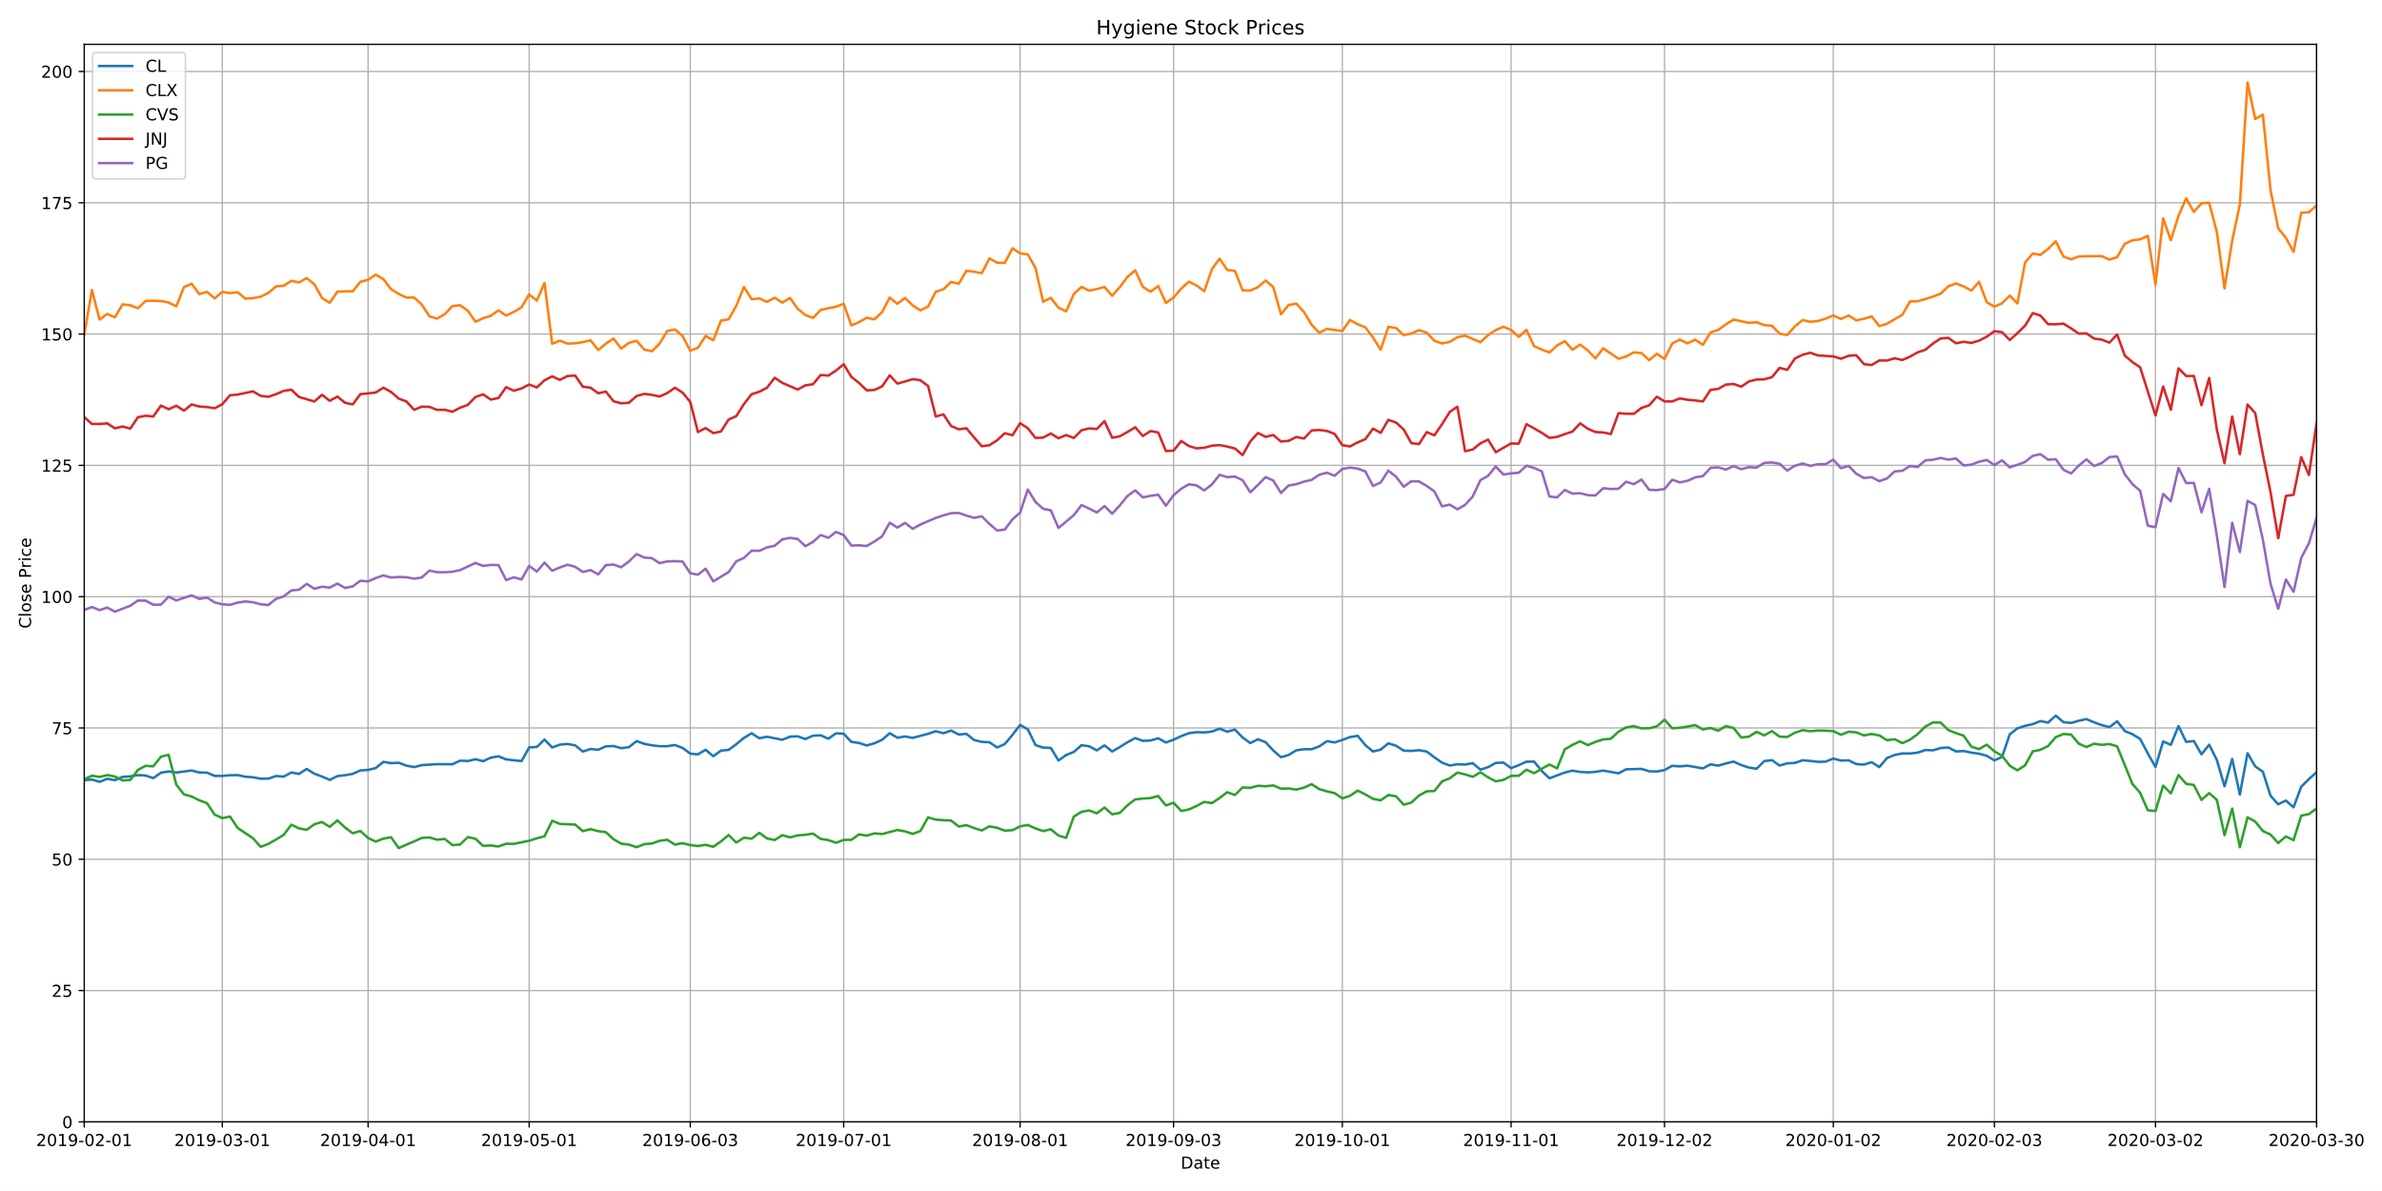
Hygiene Stocks

Slide 5
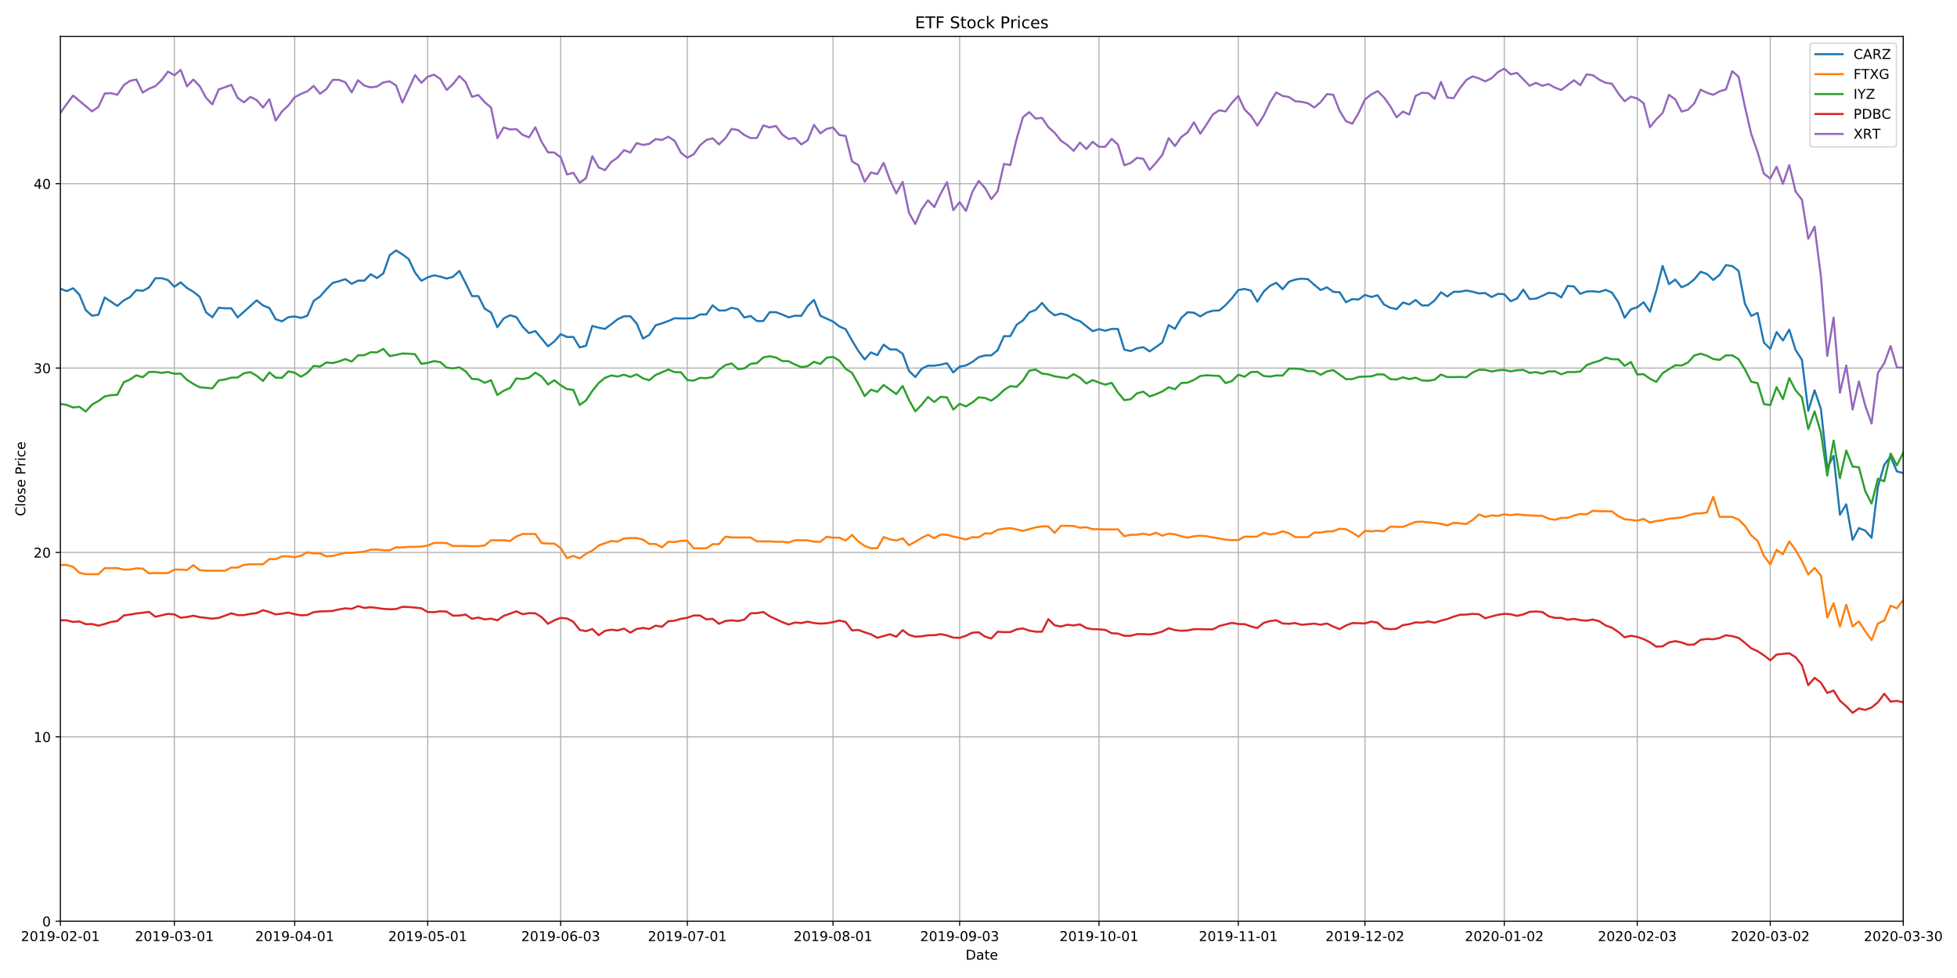
Industry ETFs
CARZ: Car Industry FTXG: Food & Beverage
IYZ: Telecommunications
PDBC: Commodities
XRT: Retail

Slide 6
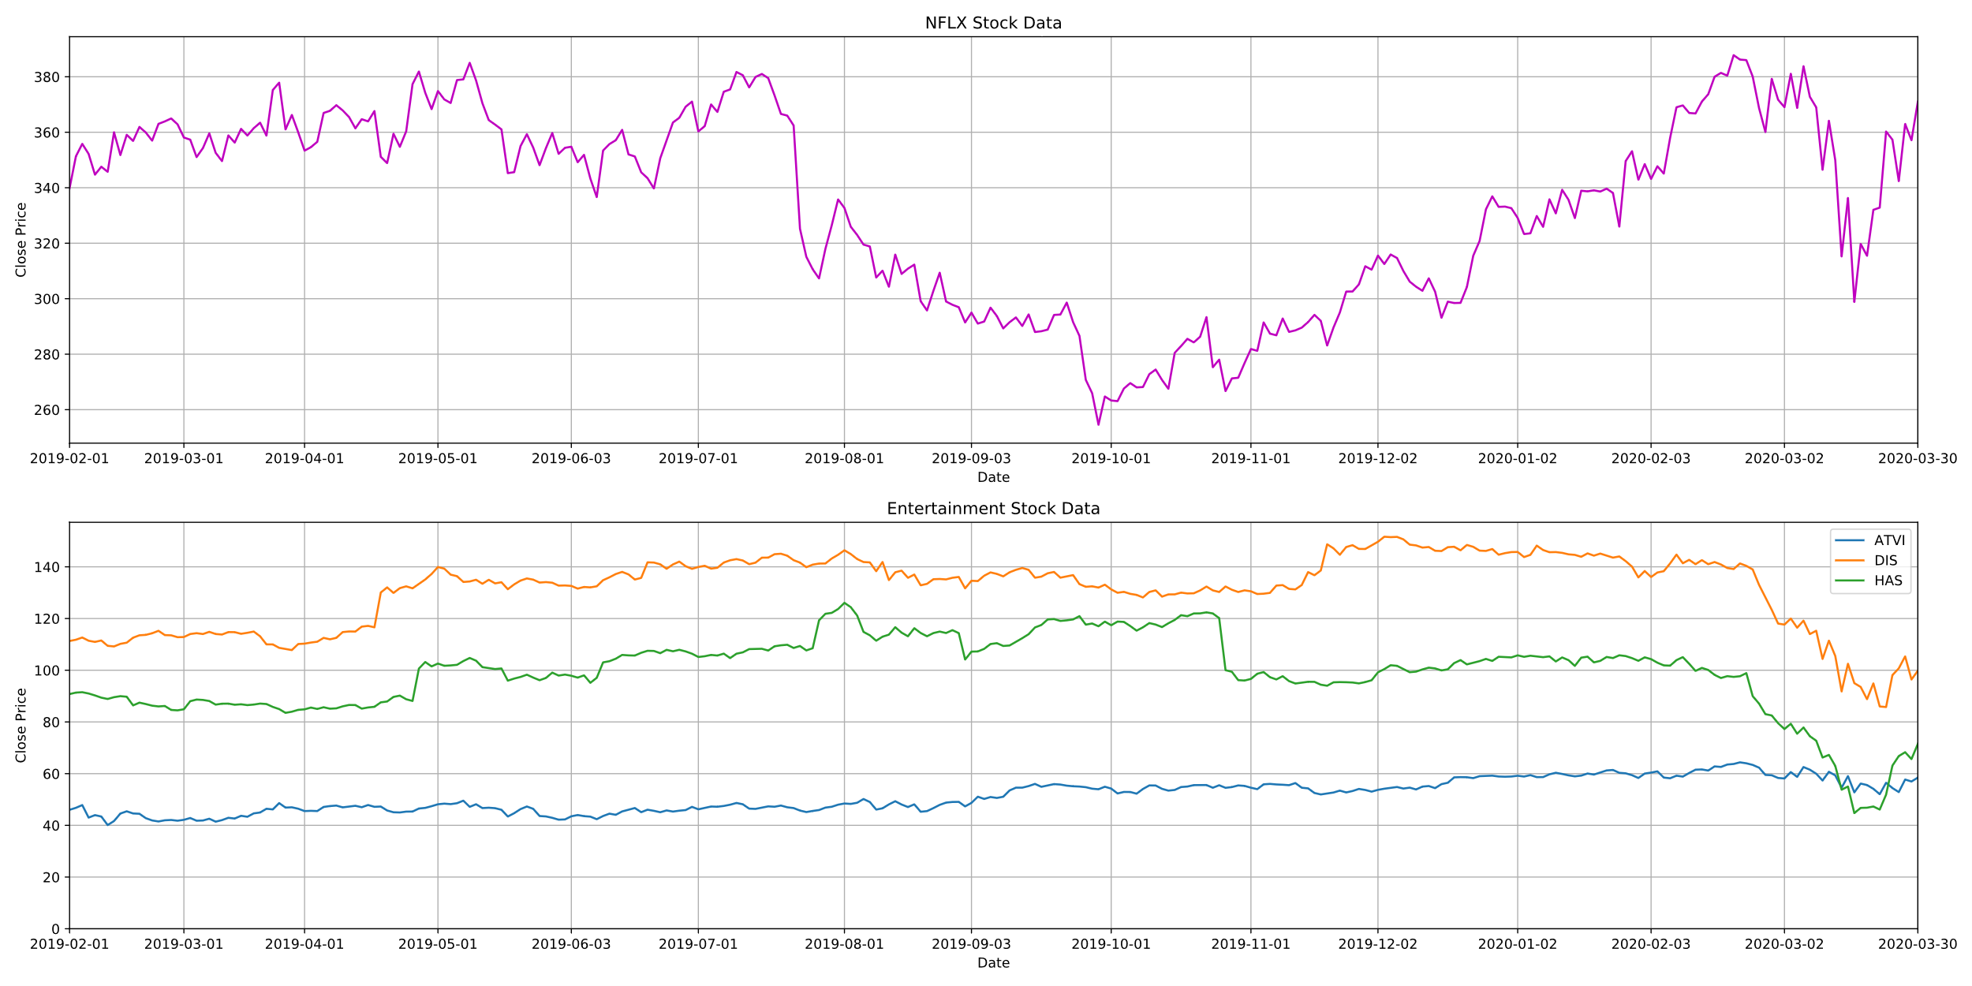
Entertainment Stocks

Slide 7
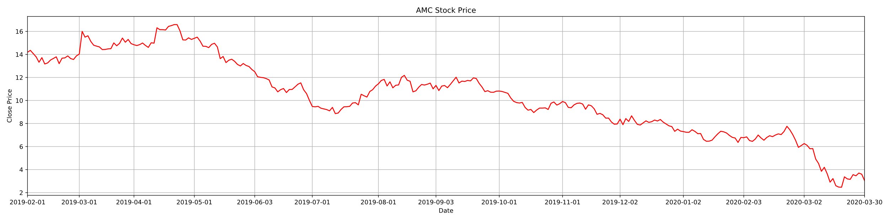
Netflix had a sharp decline, but bounced back quickly
Activision-Blizzard had almost no decline.
AMC went down to almost $2/stock compares to over $14/stock this time last year
Disney hit harder than anticipated given the popularity of Disney Plus

Slide 8
Conclusion
Unsurprisingly, retailers and the car industry took an enormous hit due to COVID-19.
Walmart, however, did not decline as much as anticipated.
Markets not shown behaved as expected, sharp declines mostly in mid March.
Clorox is the only stock we looked at that actually improved due to the pandemic, outperforming competitors.
The entertainment companies as a whole took less of a hit than anticipated.
Limitations
Low sample size
Somewhat limited API
Time

